Slide 1
GSpy: Ground Support Python Software for ESA’s EnVision Venus Mission –
Technical Introduction and Protocol Extension Walkthrough
Notes:
AI-generated content may be incorrect. --- This presentation introduces GSpy, the ground support software developed in Python for ESA's EnVision Venus mission. We will cover its technical aspects, integration with SpaceWire hardware, protocol extension, device connectivity, and best development practices.

Slide 2

Agenda Overview
Technical Overview of GSpy Software
Integration with SpaceWire Test Equipment
Extending GSpy: Adding a New Protocol Service
Connecting to and Testing with SpaceWire Devices
Notes:
--- We will look at the technical overview of GSpy software, its integration with SpaceWire test equipment, how to extend GSpy by adding new protocol services, connecting and testing with SpaceWire devices, and conclude with best practices and development guidelines. Image source: Microsoft 365 content library

Slide 3
Technical Overview of GSpy Software
Notes:
This section provides an overview of GSpy software, including its purpose for the EnVision mission, key technologies such as Python and PyQt6, and its architecture with main features.

Slide 4
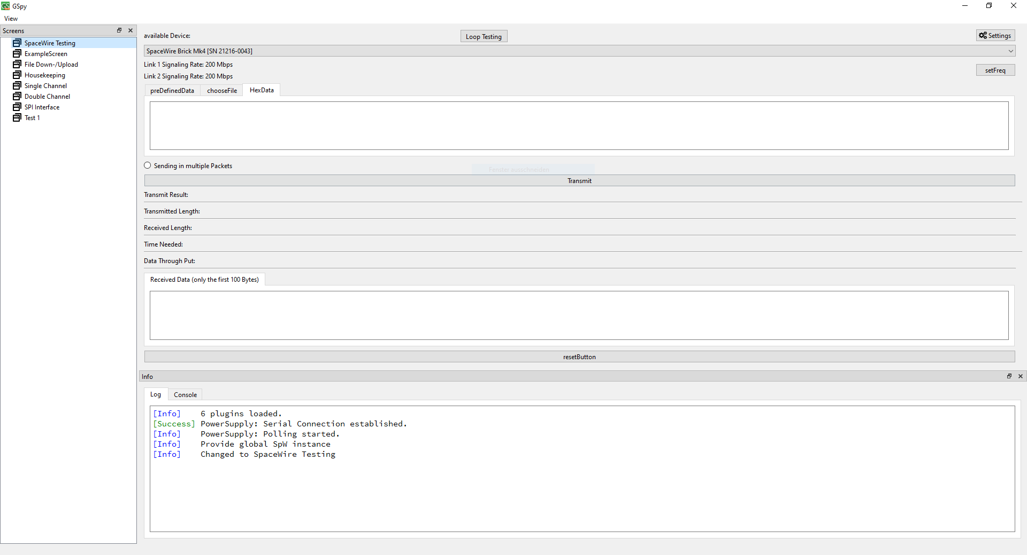
Key Technologies: Python and PyQt6
Python Programming Language
PyQt6 Framework
Flexible GUI
Compatible with Windows and Linux
Easily Extensible through plugin system
Build-in support for Recorder, Logging and Command Line
Notes:
--- GSpy is developed primarily in Python leveraging the PyQt6 framework for its graphical user interface, providing a flexible and powerful environment for application development and user interaction. Image source: Microsoft 365 content library

Slide 5
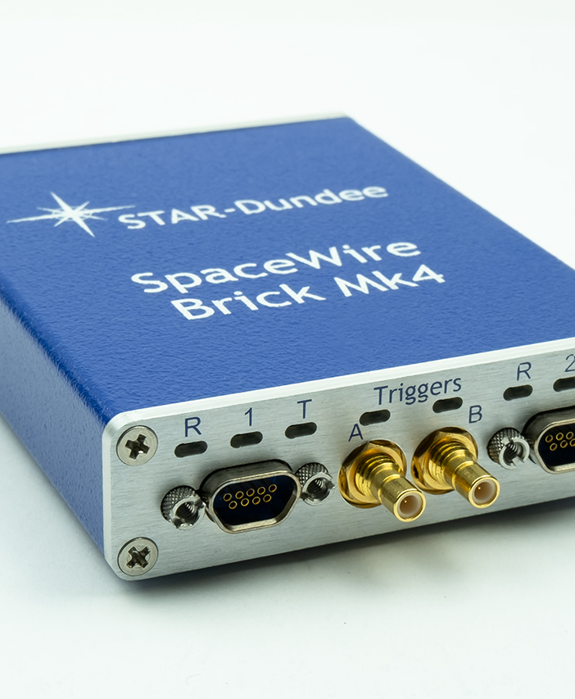
Supported Hardware
GRESB Hardware Support
SpaceWire Brick Mk4 Integration
Laboratory Power Supply
(Shimafuji Space Wire)
(Onyx SPI)
Notes:
--- GSpy supports connection with hardware like GRESB and SpaceWire Brick Mk4, enabling communication and testing over SpaceWire links essential for mission equipment validation. Image source: Microsoft 365 content library

Slide 6

Communication Workflow and Data Flow
Unified SpaceWire Interface for all SpaceWire devices
Architecture allows multiple listeners for each SpaceWire interface
Integrated Recorder for all actions and packets, incl. Replay
Currently custom recorder format
Notes:
--- The communication workflow involves data transmission and reception between GSpy and the test hardware, managing protocol packets and ensuring accurate data flow for analysis and debugging. Image source: Microsoft 365 content library

Slide 7
Extending GSpy: Adding a New Protocol Service
Notes:
Here we cover the process of extending GSpy by adding protocol services, including identifying requirements, designing views with Qt Designer, and implementing backend logic in Python.

Slide 8
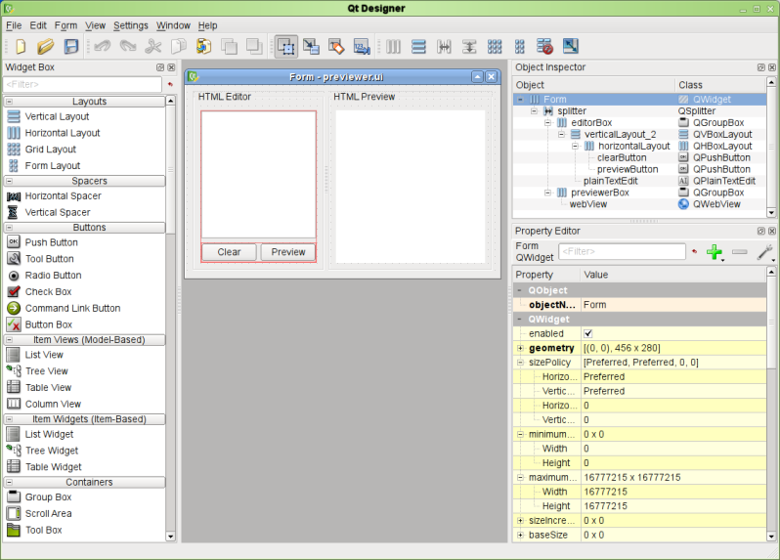
Designing a New View with Qt Designer
Visual Interface Creation
Extensive library of possible elements
Large number of custimization options
Notes:
--- Qt Designer is used to create user interface components visually, allowing developers to design new protocol views rapidly with drag-and-drop widgets and layout management. Image source: Microsoft 365 content library

Slide 9
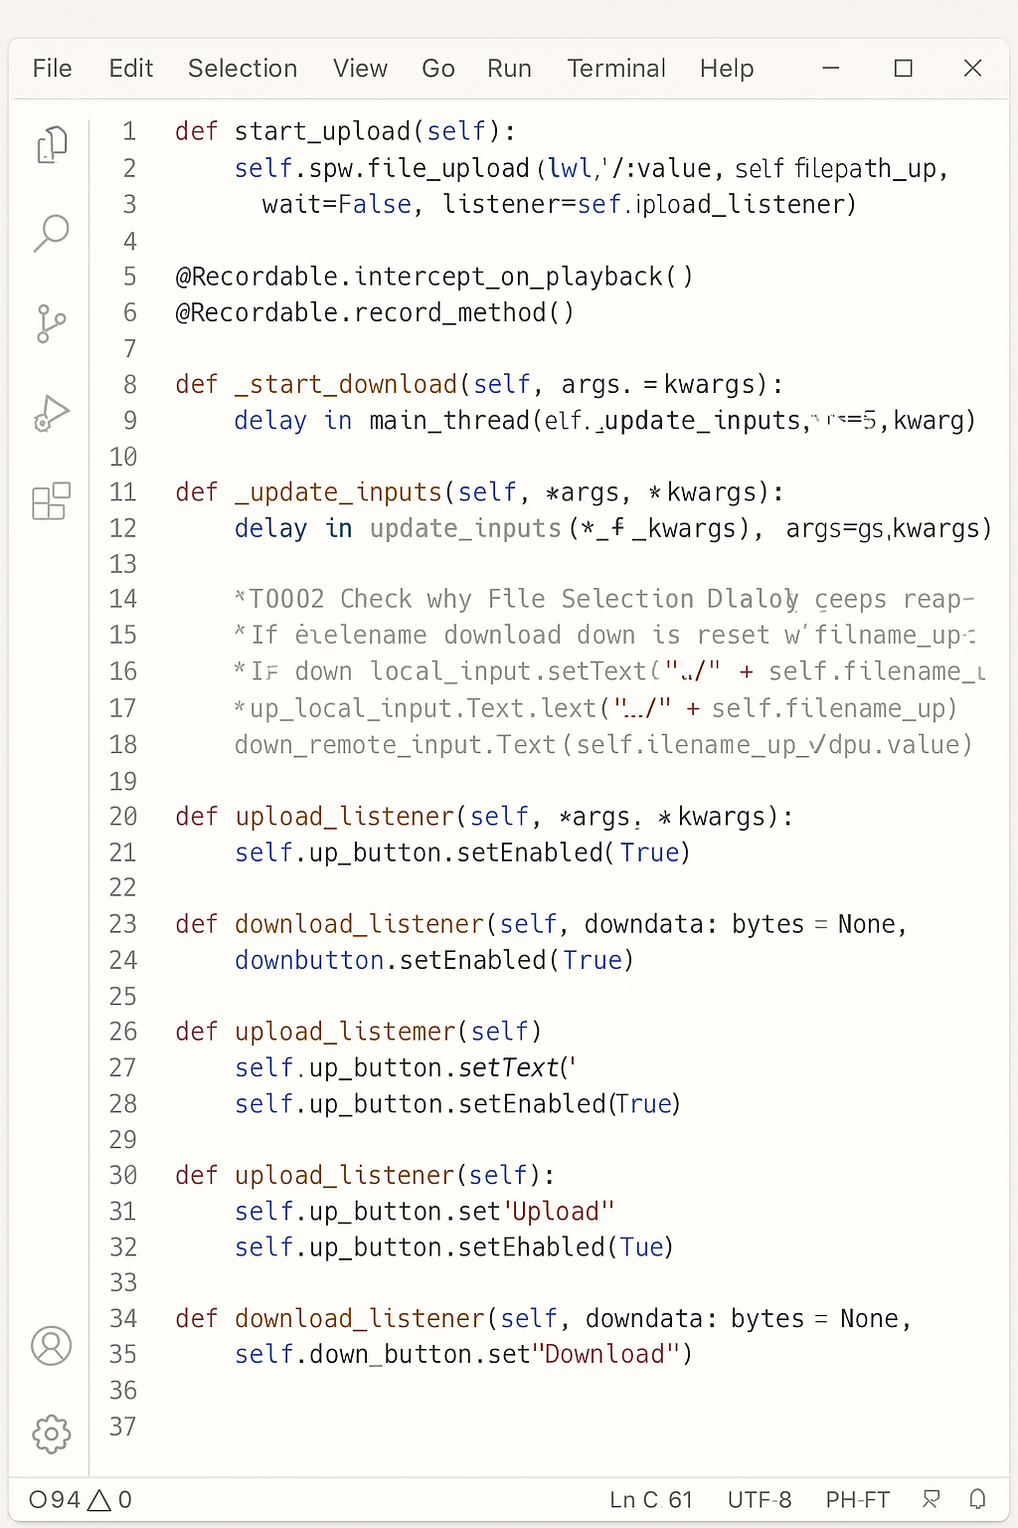
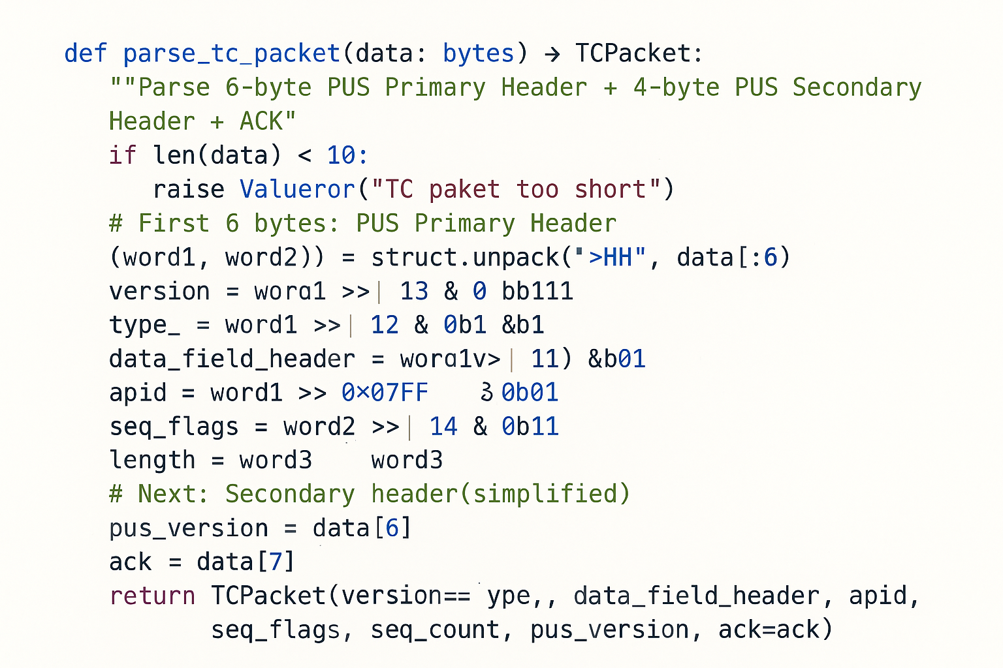
Implementing the Python Backend Logic
Actions from GUI available as Qt Slots
Output to recorder and GUI
Decode binary messages
Notes:
--- The backend logic involves coding the protocol behavior, data processing, and integration with existing GSpy modules, ensuring seamless operation of the new protocol service. Image source: Microsoft 365 content library

Slide 10
Conclusion
Based on common open source systems
Python 3.13
Modular and Extensible Design
Unlimited Parallel view of different Widgets
Heavy Development ongoing
First testing versions for MPS planned in few weeks
Qt 6
Linux and Windows compatible
Default Implementations for Recorder, Logging and a command line
Optimisation and testing still required
Current Focus on SpaceWire
Notes:
GSpy is a critical tool supporting ESA’s EnVision Venus mission, offering advanced features for SpaceWire communication testing. Its modular design and extensibility allow adaptation to evolving mission needs, supported by best development practices.

Slide 11

Key Discussion Points
Required functionality
Format of development documentation
Format of user documentation
Testing strategy
Requirements of other project partners
Notes:
Image source: Microsoft 365 content library Identify which development steps require detailed tutorial documentation for users. Discuss features that are currently missing from the concept and gather additional feedback for improvement. Consider the needs of other partners involved, focusing on required resources, support, or integrations to ensure successful collaboration.

